Slide 1
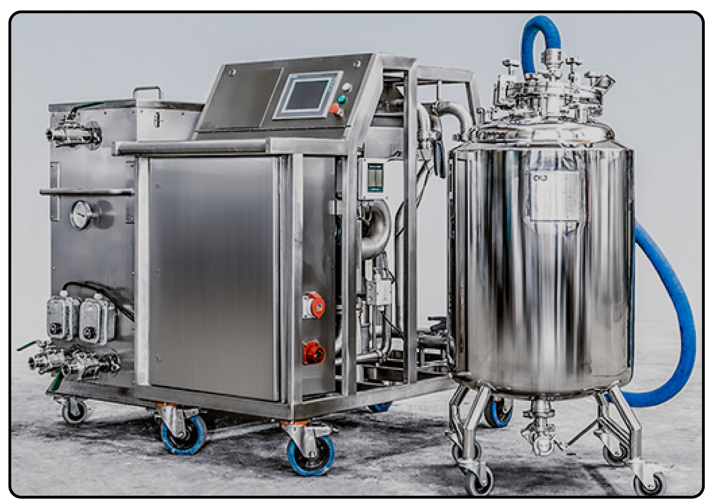


Mobile device for passivation, decontamination and resetting of industrial piping
Team 32
Christopher Wolfgang Wild s180026
Jakub Brzosko s161116
Manuel Montoya Catala s162706
Maria Katsimitsi s171869
Mathias Hald (CBS-maha16bf)

Slide 2
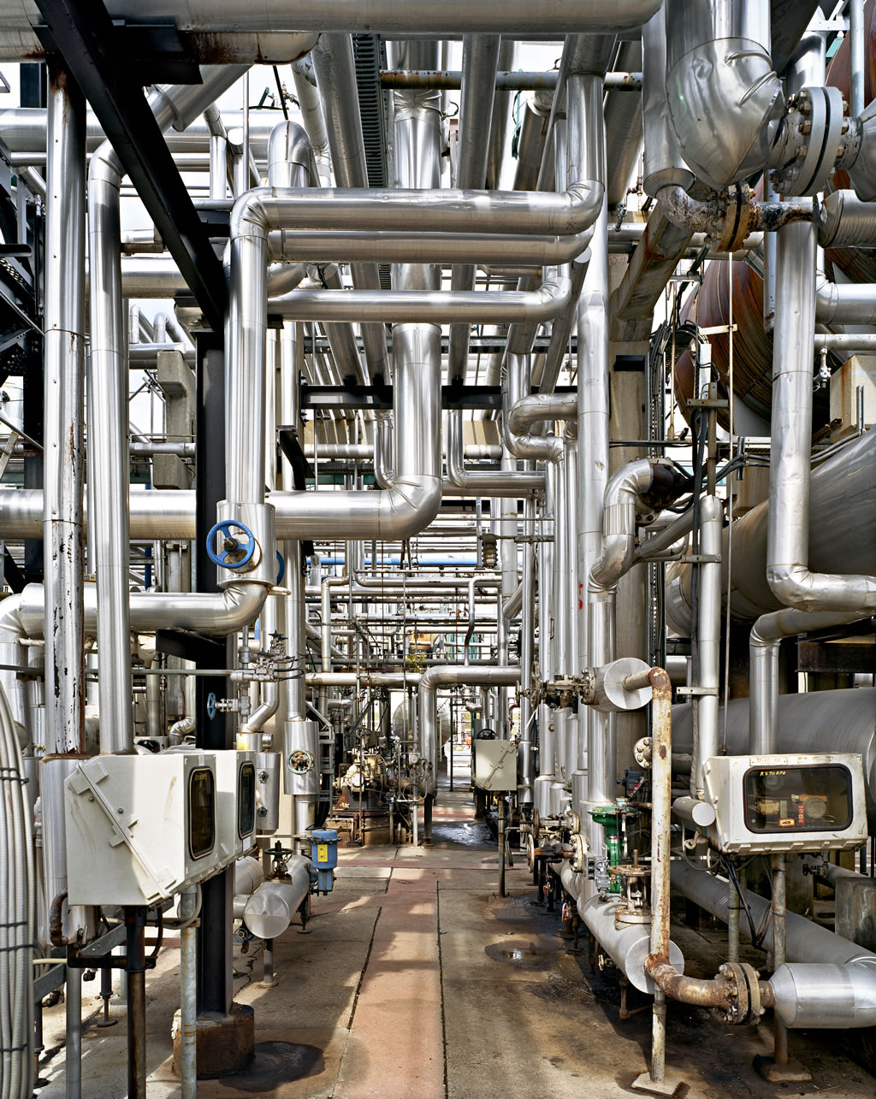
Problem
Pipelines in the Pharmaceutical Industry need cleaning every few days
It is costly to create a stationary unit for every pipeline system and they are not very flexible

Slide 3
Technology
Cleaning-in-place mobile machine:
Mobility: Fits through doors
Validation: Printed document
Sensors - ongoing monitoring and supervision
Passivation - ability to deal with intense chemicals.

Slide 4
Market
More than 26000 full-time employees in pharma industry
More than 200 medtech companies
More than 90 million dkk worth of export per year in pharma industry
At least 10 big players we know
Market hard to penetrate
Notes:
Our pharmaceutical market is big but we don’t know yet the limit of research and manufacturing in these pharmaceutical companies and is hard to approach them.
We know already 10 big players the we could be interested in our product

Slide 5
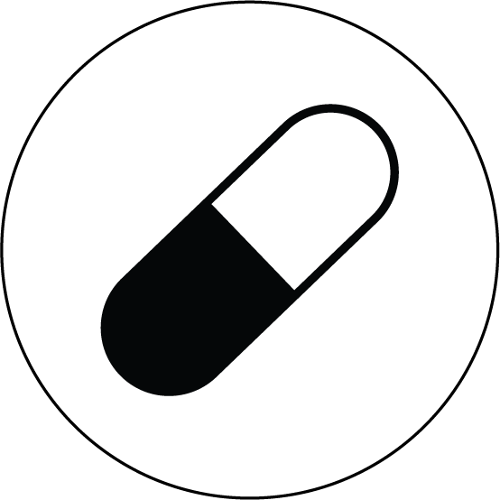
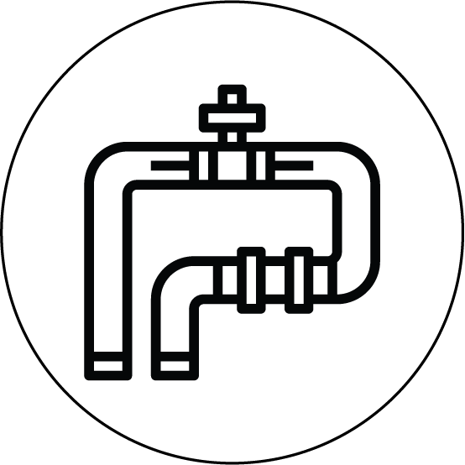
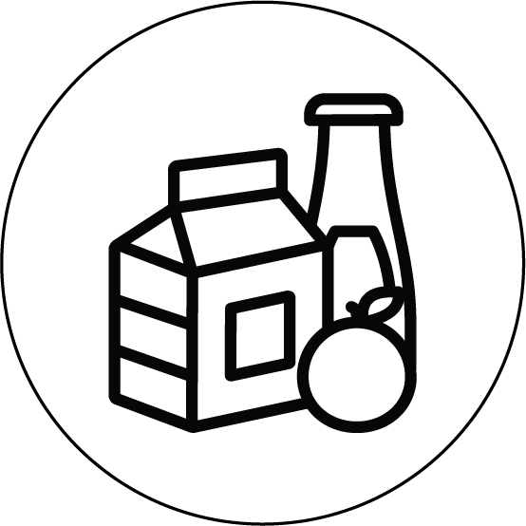
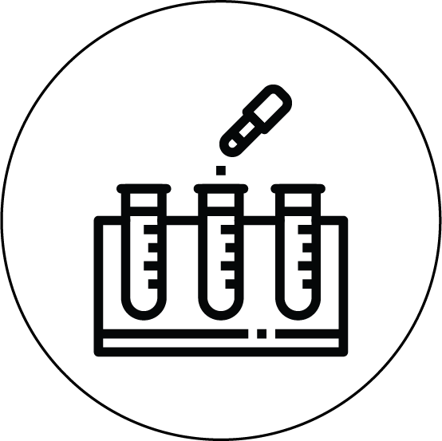
Customer
Pharmaceuticals manufacturers
Piping/ factory manufacturers
Food and drinks manufacturers
Test and research facilities

Slide 6





Competition
Mobile CIP for food industry:
Not applicable to Pharma industry
Passivation Underdeveloped
By-hand operations
Less reliable and reputable
Notes:
Not as functional as ours instead of chemicals they have soap and water
There are also the competitors that do what we do by hand which is less reputable and reliable

Slide 7
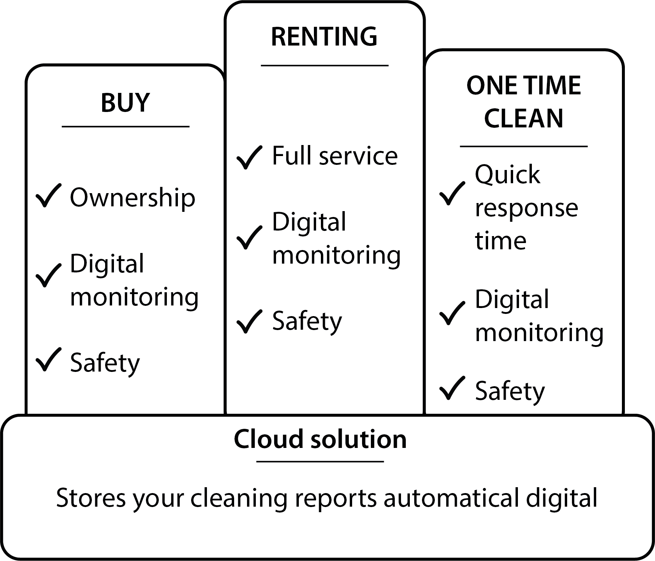
Business Model

Slide 8
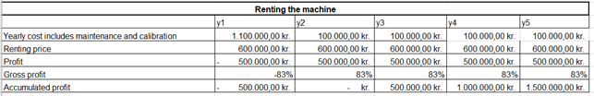
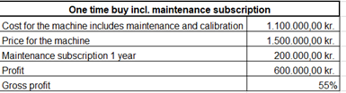
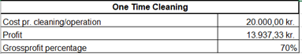
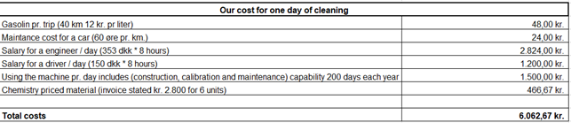
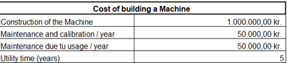
Finances

Slide 9
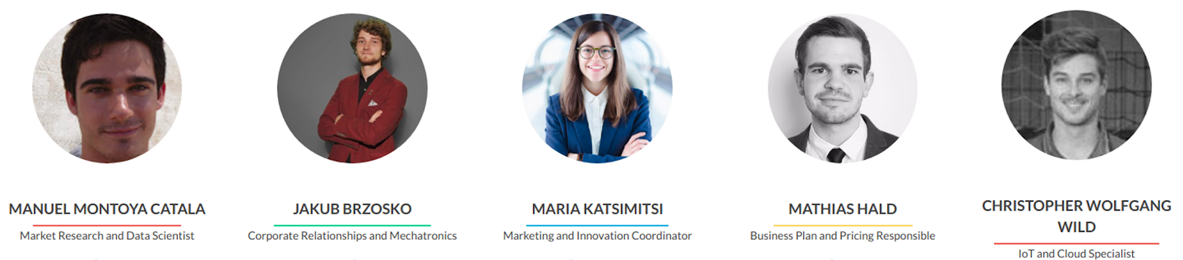
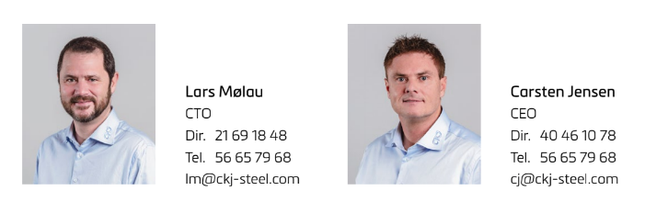
Team and Partners

Slide 10
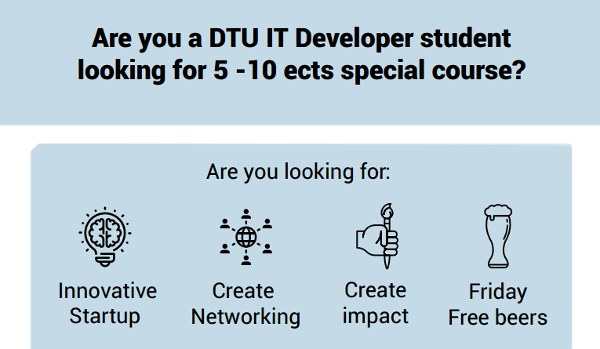
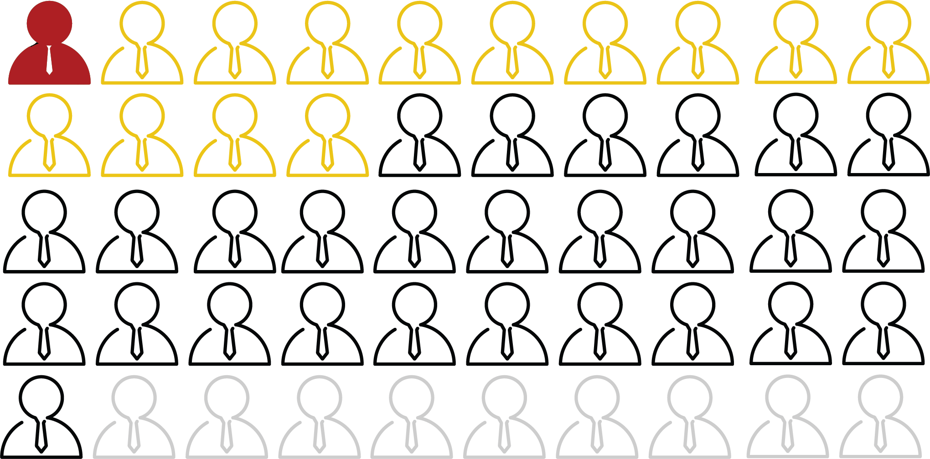
Traction
Industry demands consulted
Reporting
Safety measures
FDA compliance
Data gathering
Optimize cleaning time
Website, Beta version
50+ stakeholders contacted
13 stakeholders met
1 potential client
Hiring set of skills we were lacking
Sketch of IoT architecture created and consulted
Notes:
Through our market research we found out that reporting is needed…
We started with IoTubes.dk website which we are still working on
We understood what is the hardware and software behind and as a result we have an initial idea how to move on

Slide 11
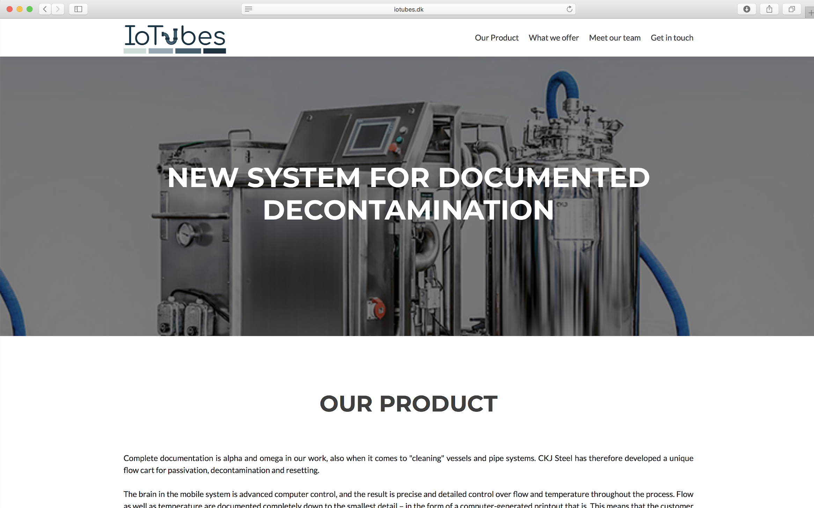
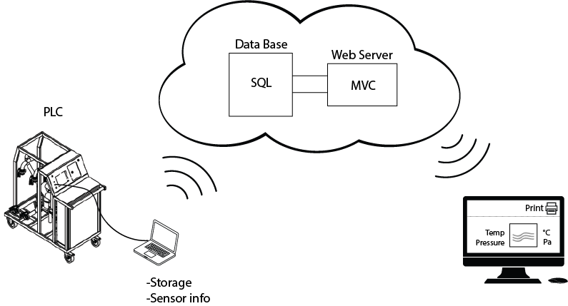
Future Goals
Developing IoT solution
Buy the PLC card
Implement Cloud Services
Report creation
Data handling
Finishing website
Arduino system with PH sensor
Contact more customers

Slide 12
Needs and Risks
Need:
Get to relevant stakeholders in time, and gather their input
Develop solution allowing data fetching from existing machines
Investigate and assess how to differentiate from competitors
Risks:
Not enough market
Not enough added value to differentiate
Slow and costly development
Notes:
Find the right people and penetrate the market fast
Develop solution….We want to differentiate

Slide 13
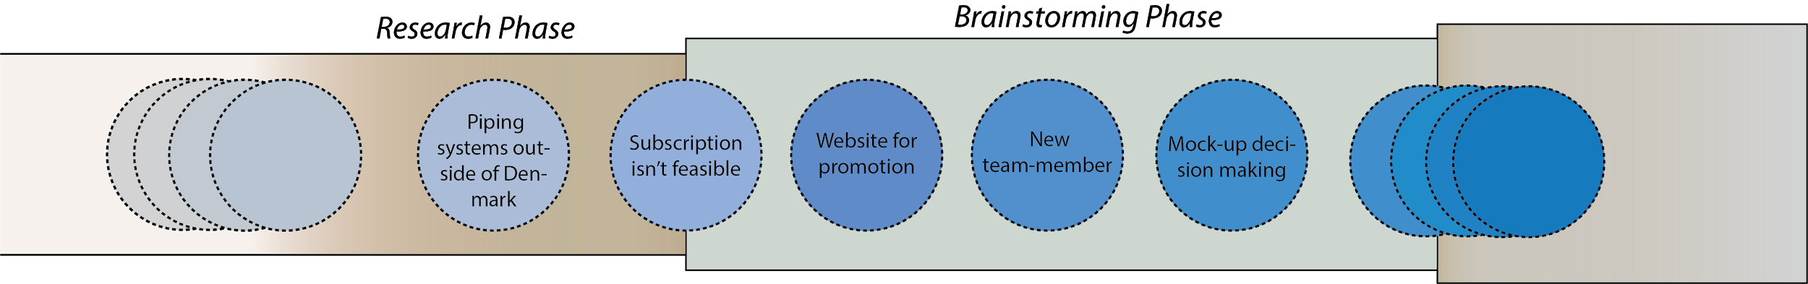
Project Progression

Slide 14
Project Progression
2 people dropped in the first week.
Not subscription anymore (since they use it often)
Many Pharmaceutical companies in Denmark have their piping systems outside of Denmark
We got a new team-member with skills we were lacking
We created a website for promotion
Decided not to create mock-up, as spendings to gains ratio is not promising

